Slide 1

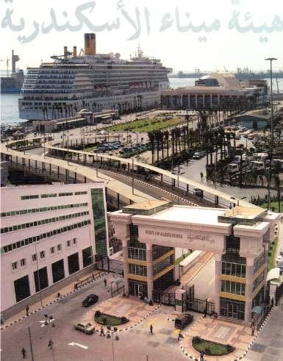

ALEXANDRIA
PORT AUTHORITY
ALEXANDRIA PORT AUTHORITY

Slide 2
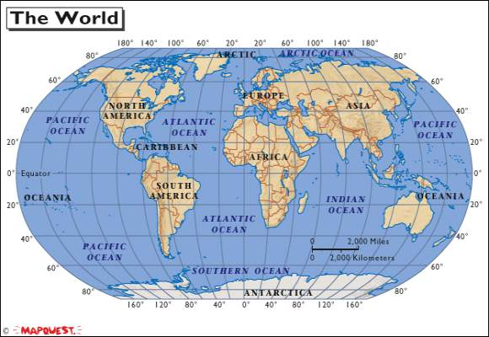
Location Of Alexandria Port
Main International Trade Route
Alexandria Port

Slide 3
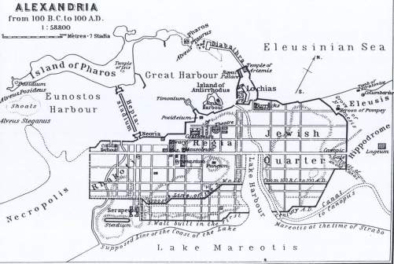
Ancient Alexandria Port
Alexandria port is one of the oldest ports in the world (5000 years old ). Alexander the great built a bridge between the coast and pharos island creating two ports: the Eastern port used for military purposes and the Western port used for commercial purposes which is the current location of Alexandria port .

Slide 4
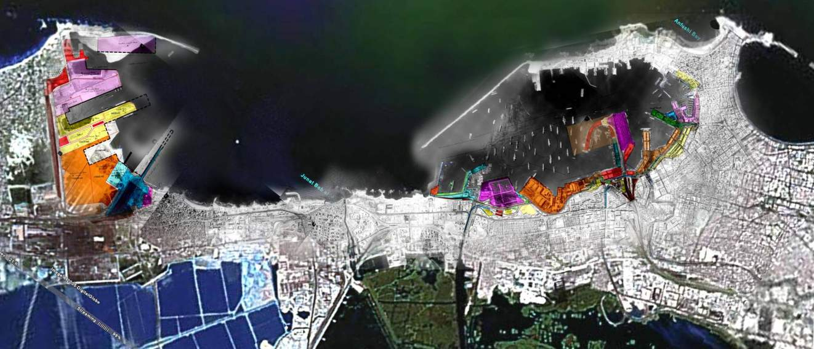
Alexandria and Eldekhiela ports in the new era
ElDekhiela port
Alexandria port
coal terminal
Alexandria Container
Terminal
Cruise terminal
Liquid bulk terminal
Grain terminal
Radar tower
Petrochemicals terminal
Grain terminal
Oil terminal
Shipyard
Container terminal
Live stock terminal

Slide 5
General Data for Alexandria and El-Dekheila ports
Item | Alexandria | El Dekhiela
Water surface area km² | 6.8 | 2.74
Land surface area km² | 1.6 | 3.5
Total number of berths | 67 | 14
Total berths length/Meter | 10600 | 4400m
Depth/Meter | 8.5 - 14 | 10 - 20
Hinter land m² | 1650000 m² Including management buildings & warehouses | 3500000 m² Including management buildings & outer area
Terminals | 20 | 6

Slide 6
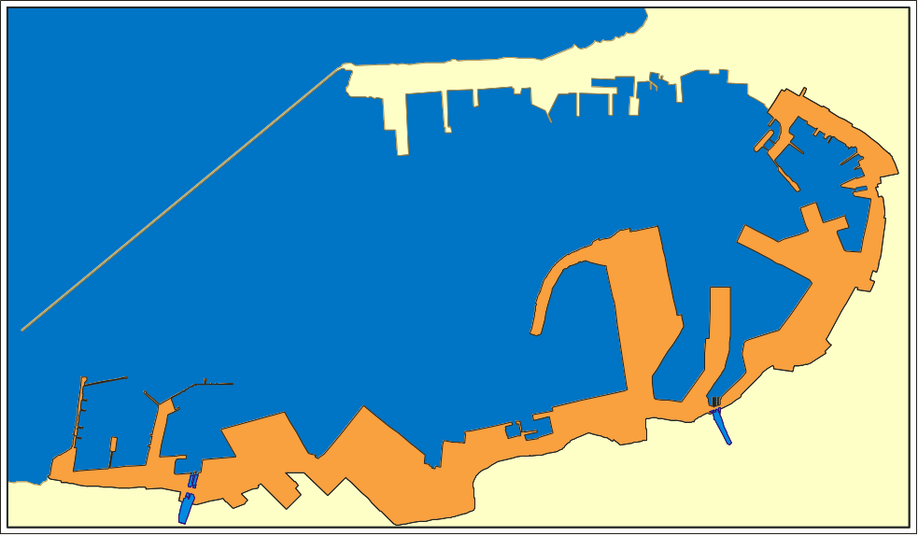
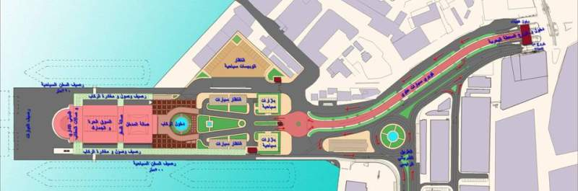
The cruise terminal
and tourist area
Total Area is 70,000 m2
Cruise terminal
Fountain
Landscape
The bridge
The tourstic
street
to
Berths
Gift shops
Parking
The Tourist train station
The main gate

Slide 7
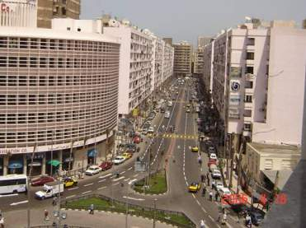
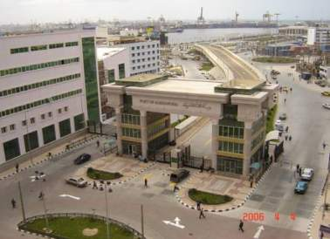
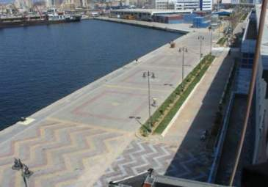
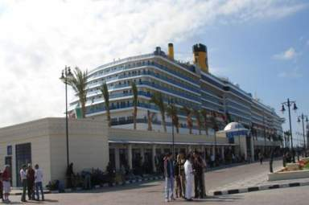
Tourist st.
Main gates
The berths
Gifts shops

Slide 8
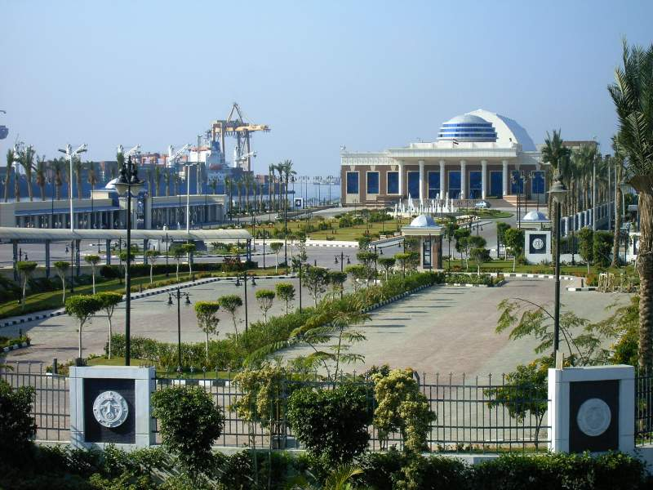
Cruise Terminal

Slide 9
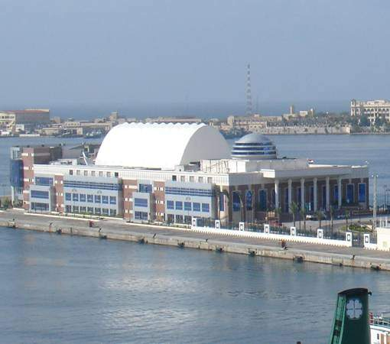
Cruise Terminal
Total surface area = 8725 m²
107 shops , 5 restaurants
& 3 cafes
Total invested area = 6370 m²
In addition to the open area = 2400 m²

Slide 10
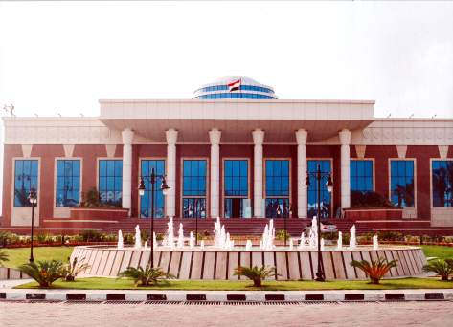
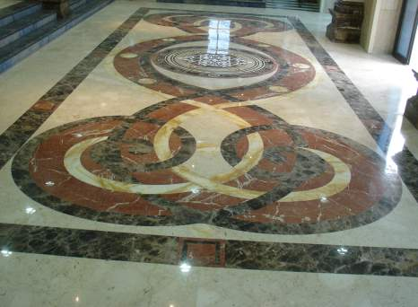
The Terminal from inside

Slide 11
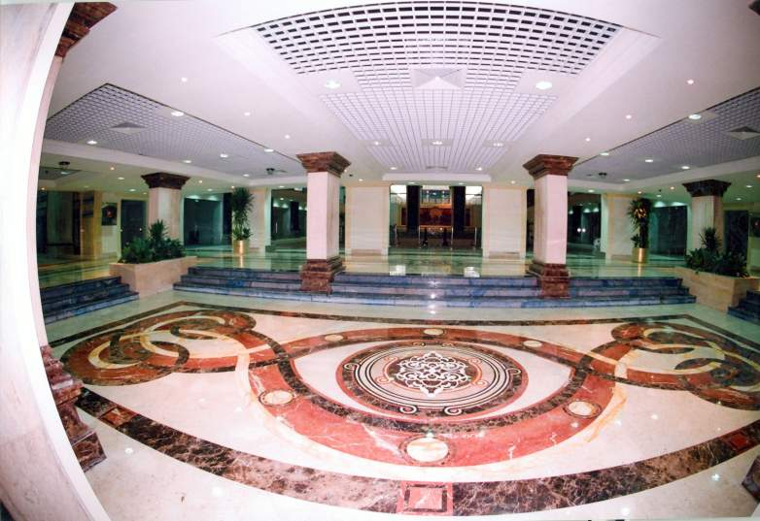

Slide 12
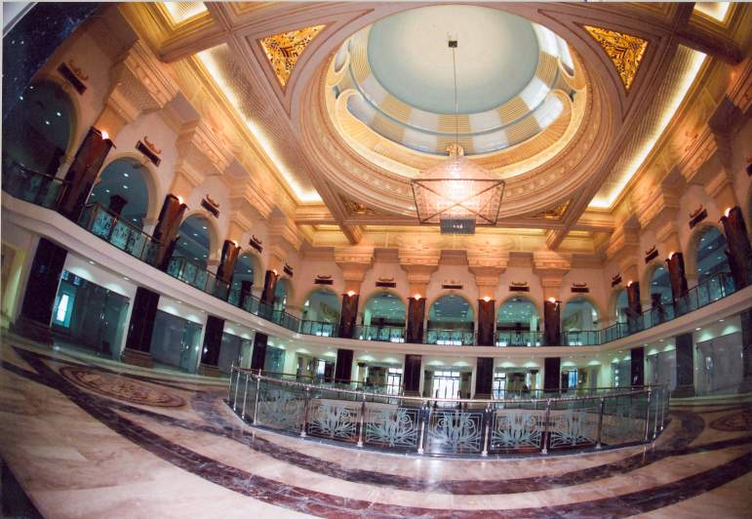

Slide 13
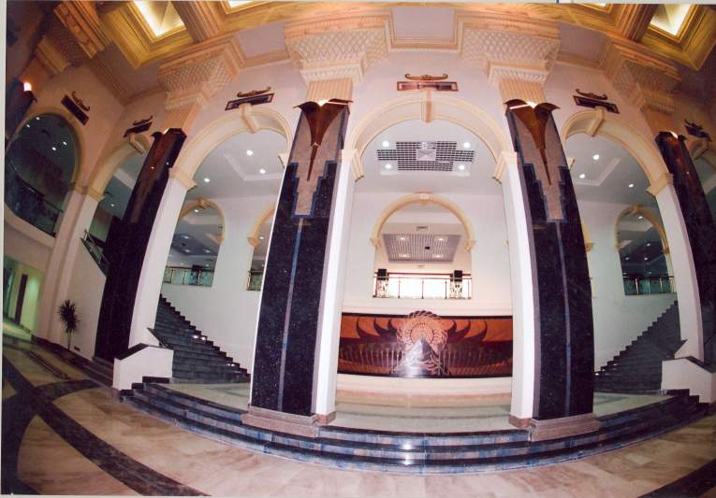

Slide 14
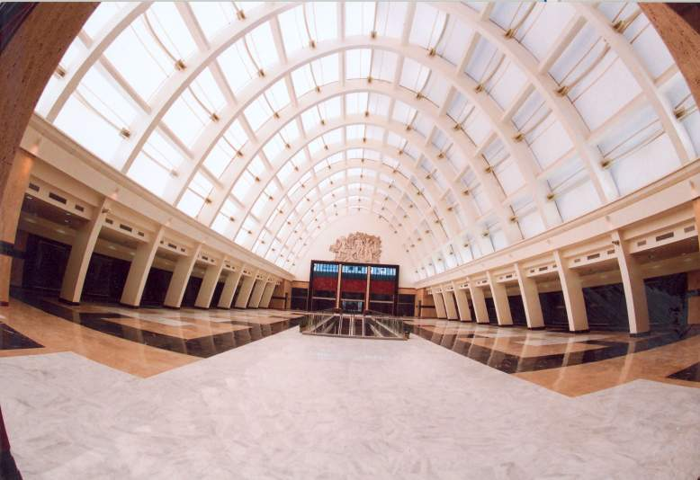

Slide 15
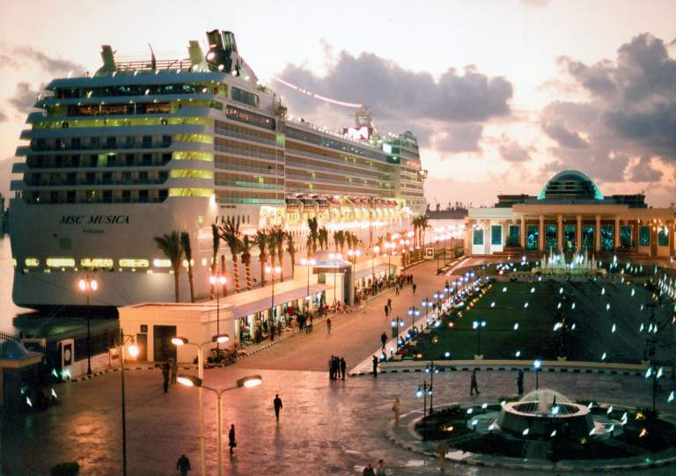

Slide 16
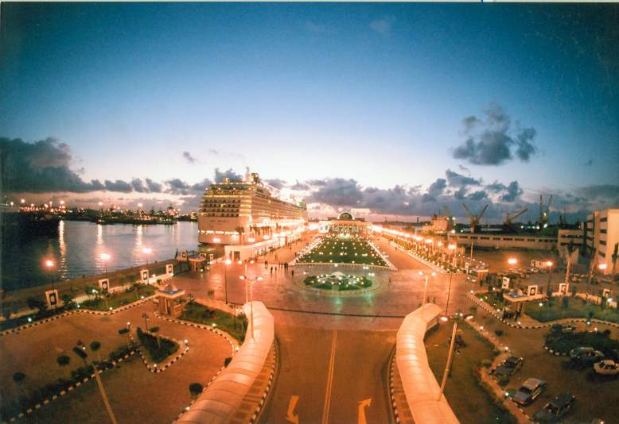

Slide 17
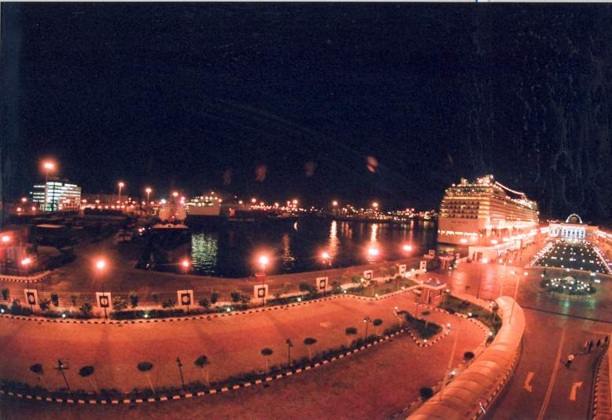

Slide 18
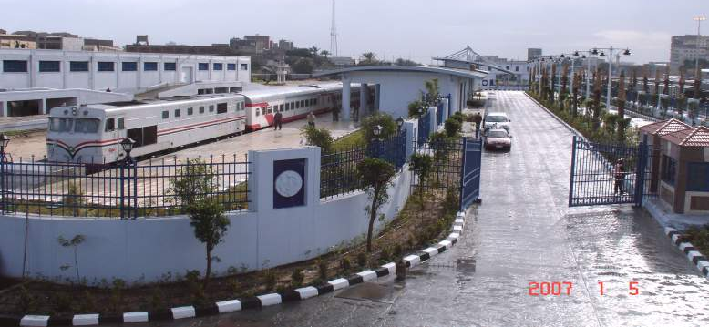
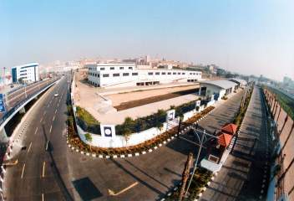
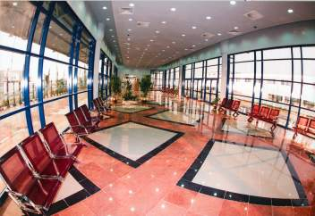
Tourist Train station

Slide 19
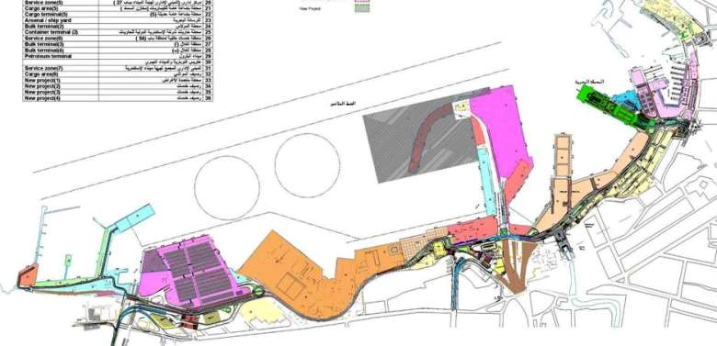
Cargo Terminals
-Total area is 300,000 m². 20 terminals
Reorganization of
the port gates
Roads
Infrastructure
Environment
protection
Buildings
yards
berths

Slide 20
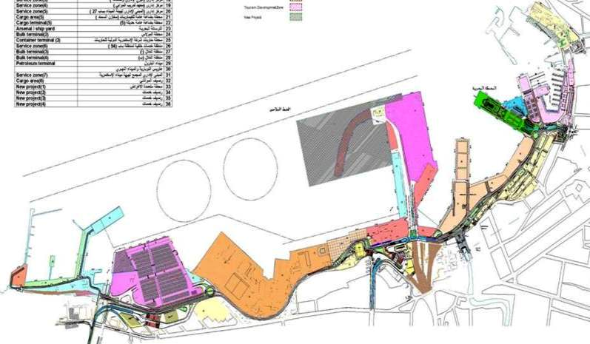
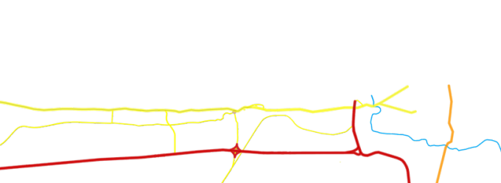
New modern 4 main gates instead of 57 gates
Tourist gate
To Alexandria city
To the high ways
To the high ways

Slide 21
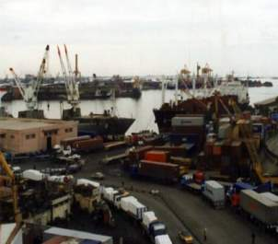
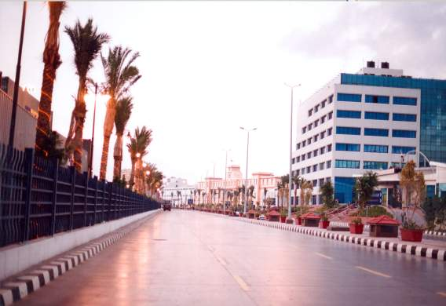
Road:
Total length of main and back roads is 150 km
Main road
Before development
After development

Slide 22
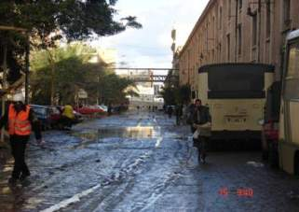
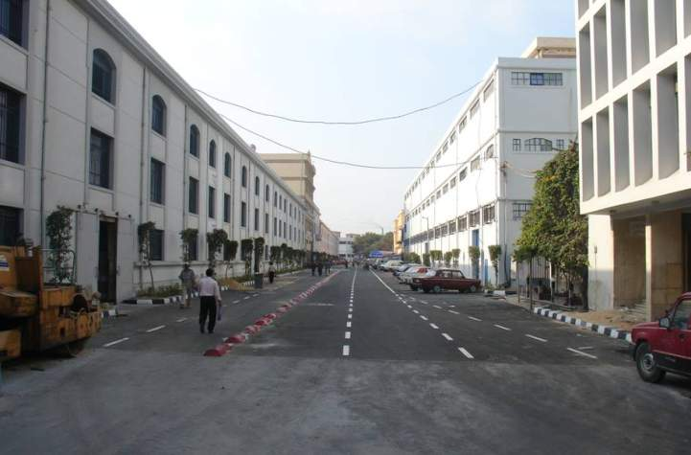
Before development
Back roads
After development

Slide 23
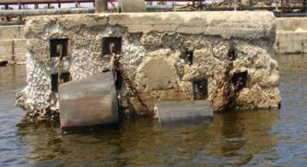
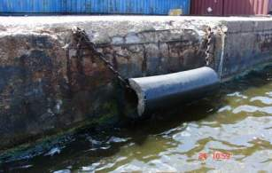
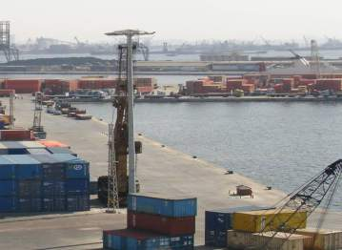
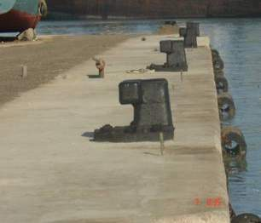
Berths
Before development
After development

Slide 24
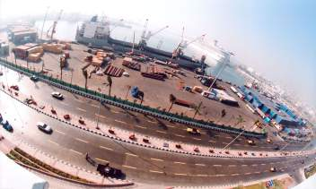
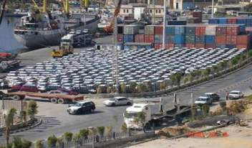
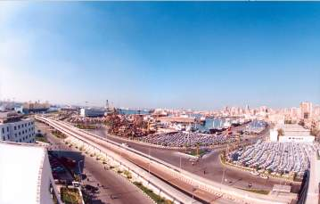
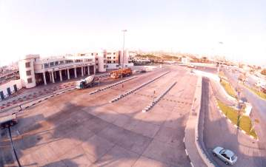
yards
Total area 360000 m2

Slide 25
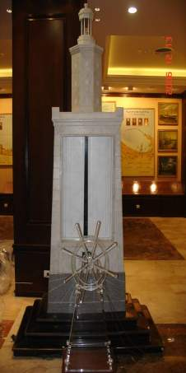
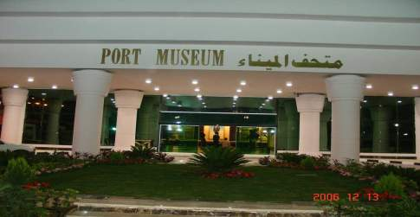
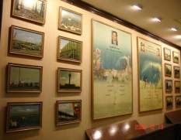
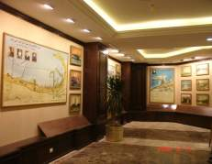
Port Museum
As Alexandria is one of the oldest ports, we established the port museum

Slide 26
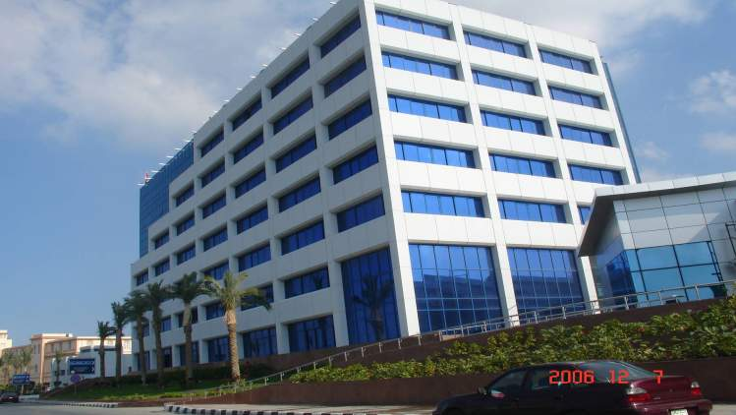
The new building
for business offices , banks , shipping agents…etc.
1 – المنشآت الجديدة (عدد 40 منشأ)

Slide 27
Applying security and safety systems
ISPS code : In May 2004 an assessment for Alexandria port was done, the port security plan was ready and started in June 2004 .
CSI and Mega-ports systems : Alexandria port authority started negotiations with USA customs to apply CSI and Mega-ports systems in the port

Slide 28
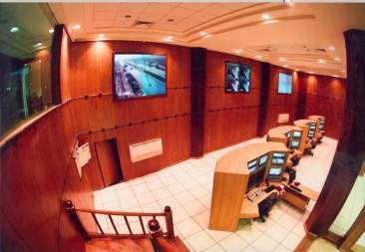
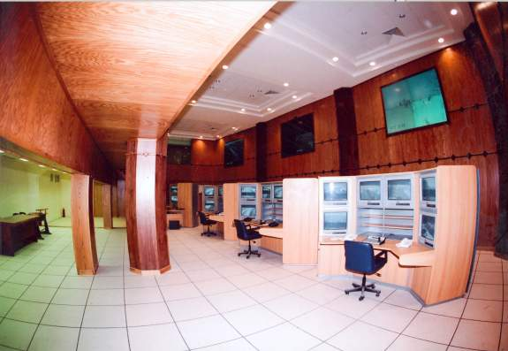
A DVC system with 264 fixed and mobile cameras is being installed to monitor all the port areas including the water surface, the anchorage area and the port entrance.

Slide 29
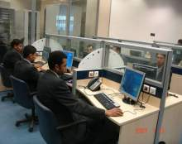
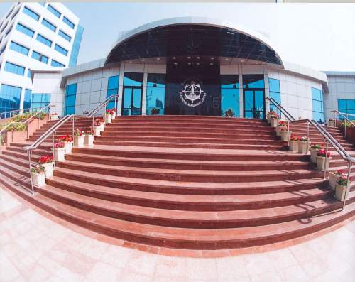
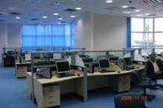
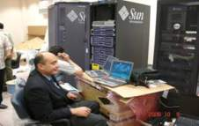
Data center
Operations planning
Operations control
Observation

Slide 30

Logistic centers
One stop shop
Decreasing Required
Permits
Submit One set of
documents

Slide 31

sub-electronic centers
Facilitate Inspection
procedures with
customs and GOIEC

Slide 32



radar tower , VTMIS and AIS systems
Control Vessels
Locating Vessels
Direct the Ingress and Egress
Of Vessels

Slide 33


Weighing bridges
(12 in Alexandria – 8 in ElDekhiela)
Calculate overweight
for the roads fees
Calculate overweight
for customs

Slide 34

Automated gates
Reducing traffic congestion
in the port
Admission trucks only
When it is time for loading
Forbid the Egress of
Unreleased Cargo
Directing trucks to yards by
Routing Ticket

Slide 35

Port control system 264 video cameras
Water surface control
Land surface control
Network and infrastructure control

Slide 36
Procedures and total no. of signatures before/ after applying IT systems
 | Department | Before |  | After
 |  | procedures | Signatures | Procedures | Signatures
1 | customs | 38 | 28 | 1 | -
2 | Imports | 20 | 17 | - | -
3 | Exports | 11 | 12 | - | -
4 | Lab. | 16 | 16 | - | -
5 | Certificates of origins dep. | 10 | 6 | - | -
Time |  | 2 days |  | 5 hours

Slide 37







Applications
Port management system
Automated gates
Passengers
SPS
Smart port solution
SPARCS
Massages
Stevedoring “containers”
General cargo management system
General cargo stevedoring system
Container management system

Slide 38
The Great Investment Projects In Alexandria Port

Slide 39

Establishing Multi purpose Terminal ( Containers – General cargo ) in Alexandria port with a length of 2140 m. and a depth of 14 m. and a back area of 375 thousand m2.

Slide 40


Operating and managing the Cruise terminal
Operating and managing Tourist train station

Slide 41

Developing the old area of Alexandria port (El Gona) by Establishing an International Marina that will has a capacity to receive 500 yacht (an integrated touristic project which will include a commercial center and 5 stars Hotel).

Slide 42


Slide 43

Establishing a new terminal ( green Terminal) on berth 65 , 66 with a length of 284 m. and a depth of 10m. by developing the current fridge with a capacity of 6000 tons, and establishing new 2 fridges on 7500 m. The project will include a shipping line between Alexandria and EU Ports.

Slide 44


A detailed feasibility study includes the way of transfering the warehouses of berths 65, 66 to refrigerators and the way of developing the existing refrigerators , and time plan for that.
Warehouses
Central Refrigerator

Slide 45
Investment Projects in Alexandria and El-Dekhiela ports with
Land Lord System

Slide 46
1- Executed Projects in
El-Dekhiela port

Slide 47

1- Petrochemical Production Handling Terminal

Slide 48

2- International cont. terminal in El Dekhiela port
Area | 180 thousand m²
Capacity | 220 thousand TEU/year
Length of the berth | 300 m.
Depth of the berth | 12 m.
RoRo berth with a depth of 10 m.

Slide 49

3- New Silos with a capacity of 260 thousand tons (Added to the old silos which had a capacity of 800 thousand tons).
Silos of productivity 260.000 tons

Slide 50
2- Investment Projects which are under construction in
El-Dekhiela port

Slide 51


Current Investment Projects in El-Dekhiela Port
New Facilities for producing and Handling petrochemical Materials
1- First phase: Establishing a factory for producing Polystyrene
2- Second phase : Establishing a factory for producing styrene and developing facilities for importing and exporting
Developing the grain area by constructing grain’s silos with total area 100.000 m2
Current working on Silos of productivity 390.000 tons

Slide 52
The Future Investment Projects In El-Dekhiela Port

Slide 53

1- Establishing and operating the coal and dry bulk terminal on the area beside berth 90/2 for exporting ( coal – clinker – cement – fertilizers …etc.)
COKE
CONVEYOR BELT
CLINKER
BULK CEMENT
PIER 90/2 275 MT

Slide 54

2
2- The extension of the break-water

Slide 55


3- To connect the port with the high way by Establishing high bridge
3

Slide 56
4- Developing and extension of the grain terminal with a length of 600m. (B.O.T. contract).
4

Slide 57
5
5- Establishing new berth (no. 100) with a length of 1000 m. and an area of 280 thousand m2.

Slide 58
6- The Integrated project to construct Multi Purpose Terminal with a length of 700 m. and an area of 262 thousand m2
( B.O.T. contract) .
6

Slide 59
Throughput

Slide 60


Tourists traffic
Statement | 2005 | 2006 | 2007
Total no. of cruises | 103 | 141 | 155
Passengers | 111.971 | 154.685 | 193.634

Slide 61

Total no. of ships
for Alexandria and Dekhiela Ports
Year | 2005 | 2006 | 2007
Total | 4849 | 5004 | 5288
Total no. of Ships
Total no. of Ships

Slide 62

Total Weight for Cargoes
Year | 2005 | 2006 | 2007
Weight of cargoes | 37.170.116 | 41.269.616 | 42.615.961

Slide 63

No. of containers
statement | 2005 | 2006 | 2007
No. of containers | 720034 | 802.782 | 826.823

Slide 64

THANK YOU
ALEXANDRIA PORT AUTHORITY
Website: www.apa.gov.eg

